Slide 1
Secure data Hiding in images using steganography
CAPSTONE PROJECT
Presented By: Diwakar Singh
Student Name : Diwakar Singh
College Name & Department : Central University of Jharkhand , Department of Computer Science and Engineering

Slide 2
OUTLINE
Problem Statement
Technology used
Wow factor
End users
Result
Conclusion
Git-hub Link
Future scope

Slide 3
Problem Statement
The project aims to securely hide sensitive information within images using steganography, ensuring data confidentiality and integrity. By embedding encrypted messages into image pixels, the system allows users to encode and decode data with password protection, preventing unauthorized access. This approach is useful for secure communication, data protection, and privacy preservation in digital media.

Slide 4
Technology used
Libraries:
streamlit: For building the interactive web application.
stegano: For implementing steganography (LSB method) to hide and reveal messages in images.
PIL (Pillow): For image processing and handling.
io: For handling byte streams and image data.
Platforms:
Streamlit Cloud or Local Hosting: For deploying and running the web application.
Python: The primary programming language used for development.
Other Tools:
HTML/CSS: For customizing the app's UI and styling.
BytesIO: For managing in-memory binary data of encoded images.

Slide 5
Wow factors
Password Protection for Enhanced Security: Unlike traditional steganography tools, this project incorporates password-based encryption, ensuring that only authorized users with the correct password can decode the hidden message. This adds an extra layer of security.
User-Friendly Web Interface: Built with Streamlit, the app provides an intuitive and interactive web interface, making it accessible to non-technical users. The clean design and easy navigation enhance the user experience.
Support for Multiple Image Formats: While encoding, the app supports popular image formats like PNG, JPG, and JPEG, making it versatile and convenient for users.
Real-Time Encoding and Decoding: Users can instantly encode messages into images and decode them in real-time, with immediate feedback on success or failure (e.g., incorrect password or no hidden message found).
Downloadable Encoded Images: After encoding, users can download the steganographed image directly from the app, making it easy to share securely.
Error Handling and Feedback: The app provides clear error messages and warnings (e.g., "Incorrect password" or "No hidden message found"), ensuring users understand the status of their actions.
Customizable UI with HTML/CSS: The app features a visually appealing and responsive design, with custom styling for buttons, backgrounds, and layouts, making it stand out from typical steganography tools.
Cross-Platform Accessibility: The app can be deployed on Streamlit Cloud or run locally, making it accessible from any device with a web browser.
Developer Transparency: The app includes a footer with developer information and a link to their LinkedIn profile, adding a personal touch and credibility to the project.

Slide 6
End users
Individuals for Personal Privacy:
People who want to securely share sensitive information (e.g., personal messages, passwords, or private data) hidden within images to avoid detection by unauthorized parties.
Business Professionals:
Professionals who need to transmit confidential business data (e.g., contracts, financial information, or trade secrets) securely without drawing attention.
Journalists and Activists:
Individuals in sensitive professions who require secure communication channels to share information without risking exposure or censorship.
Cybersecurity Enthusiasts:
Tech-savvy users interested in experimenting with steganography and secure data transmission techniques.
Educators and Students:
Teachers and students in fields like computer science, cybersecurity, or digital forensics who can use the tool for learning and demonstrating steganography concepts.
Developers and Researchers:
Developers working on secure communication tools or researchers studying data hiding techniques can use this project as a reference or prototype.
Government and Defense Personnel:
Agencies or individuals who need to transmit classified or sensitive information securely using covert methods.
Social Media Users:
Users who want to share hidden messages or fun puzzles with friends on social media platforms in a creative and secure way.

Slide 7
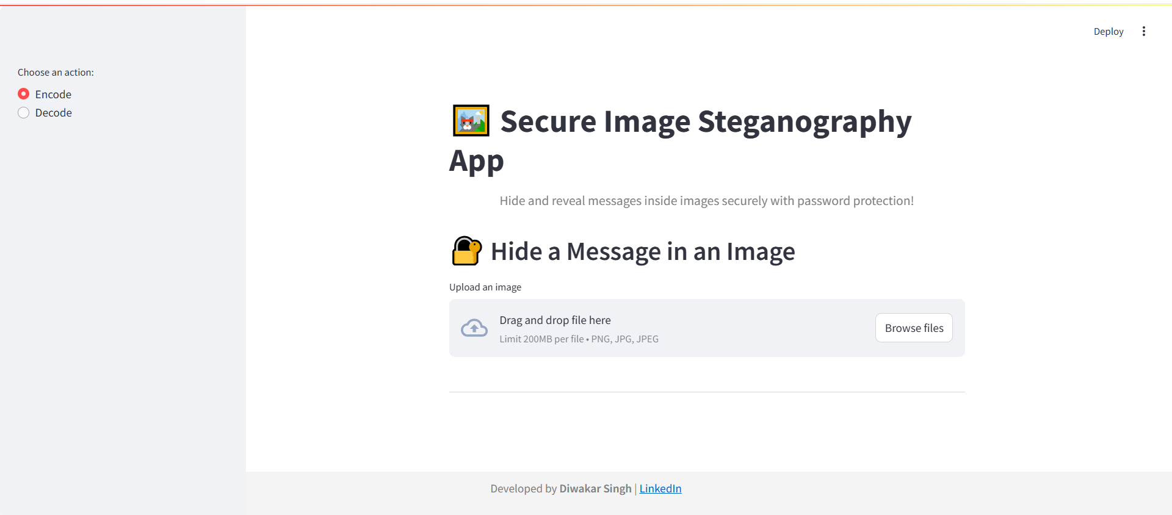
Results
GUI INTERFACE

Slide 8
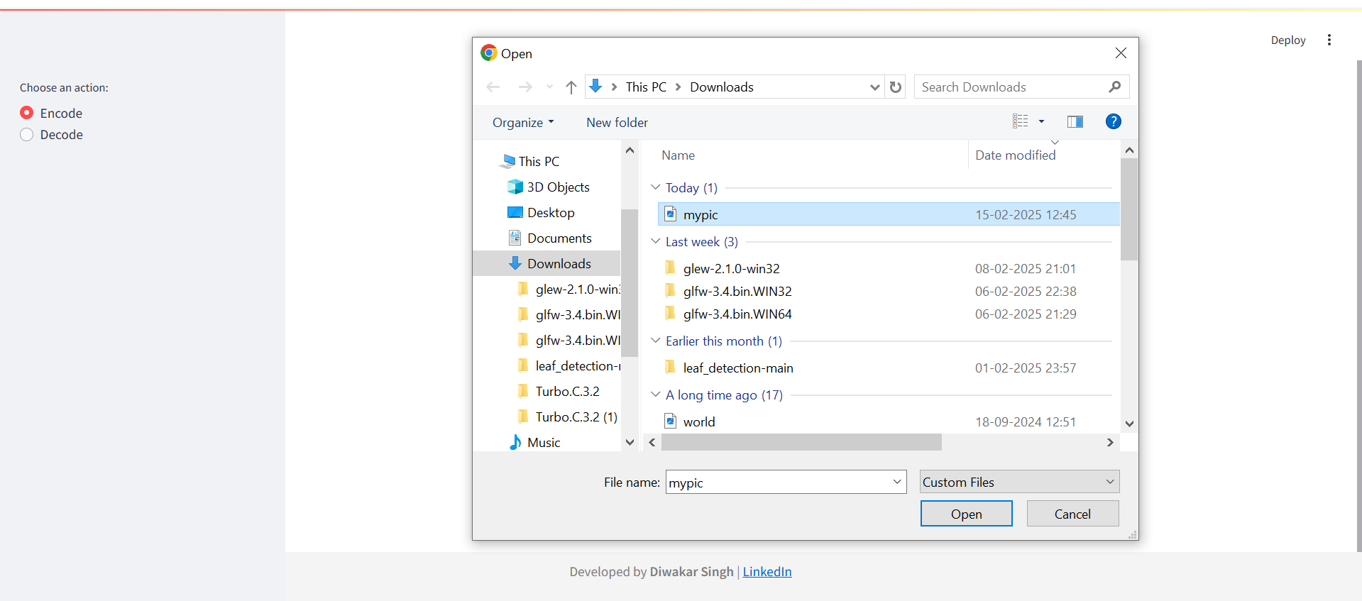
Select An image

Slide 9
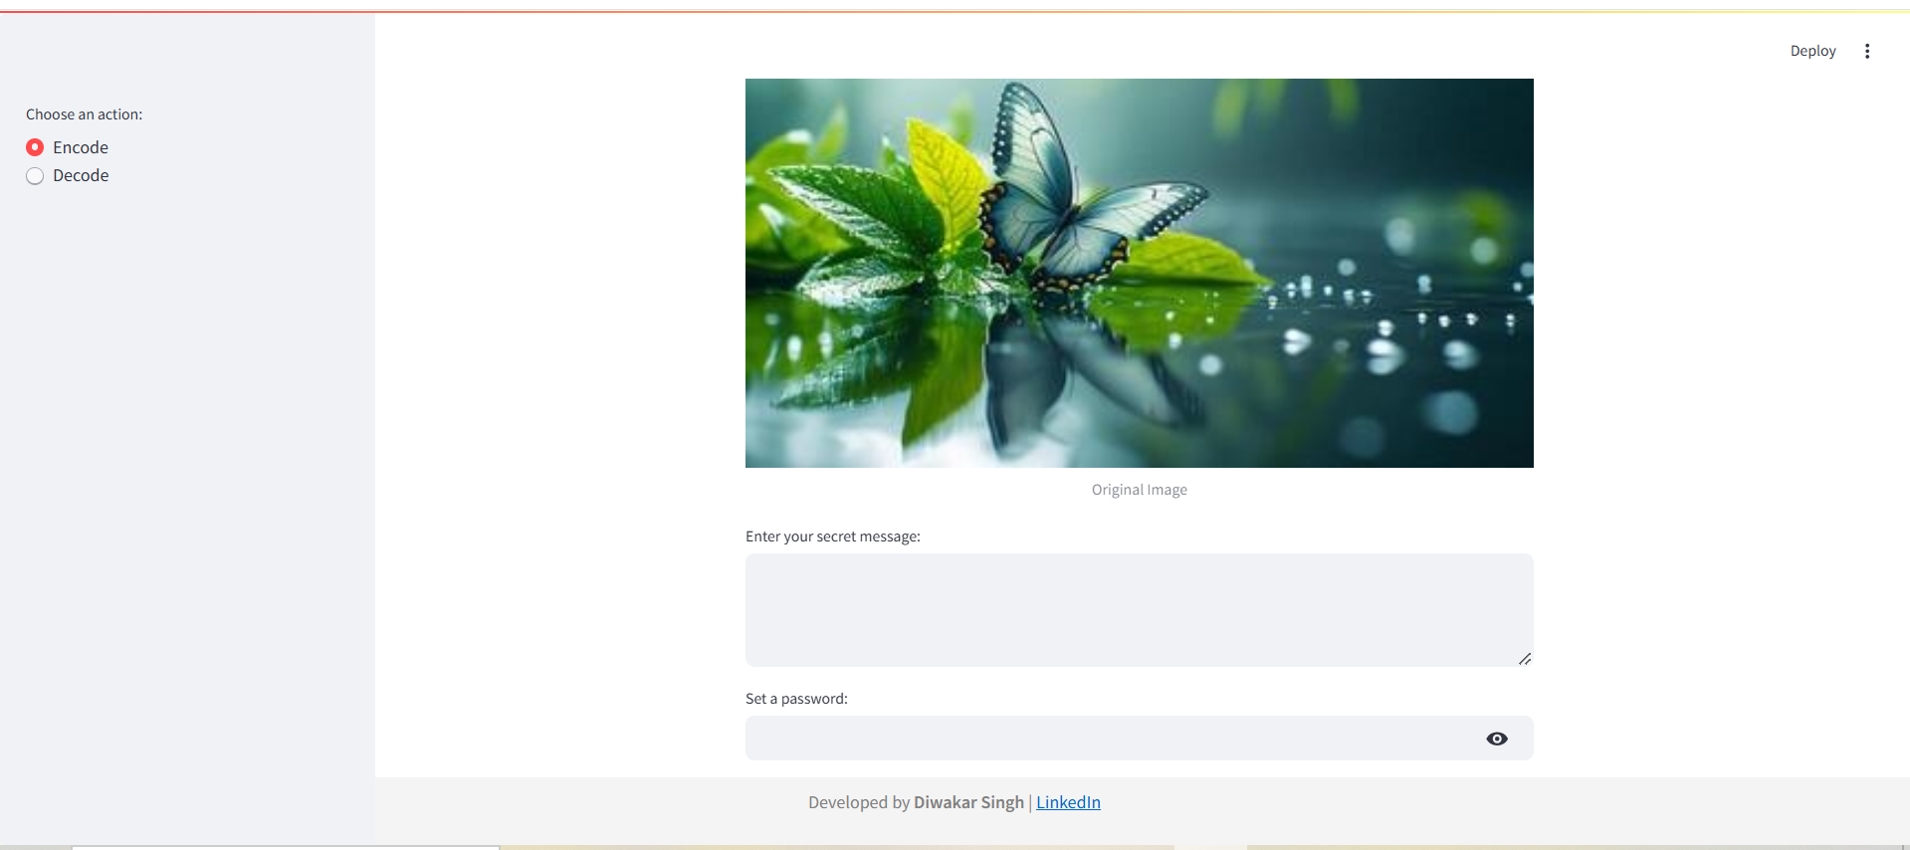
WRITE AN MESSAGE TO ENCRTPTED

Slide 10
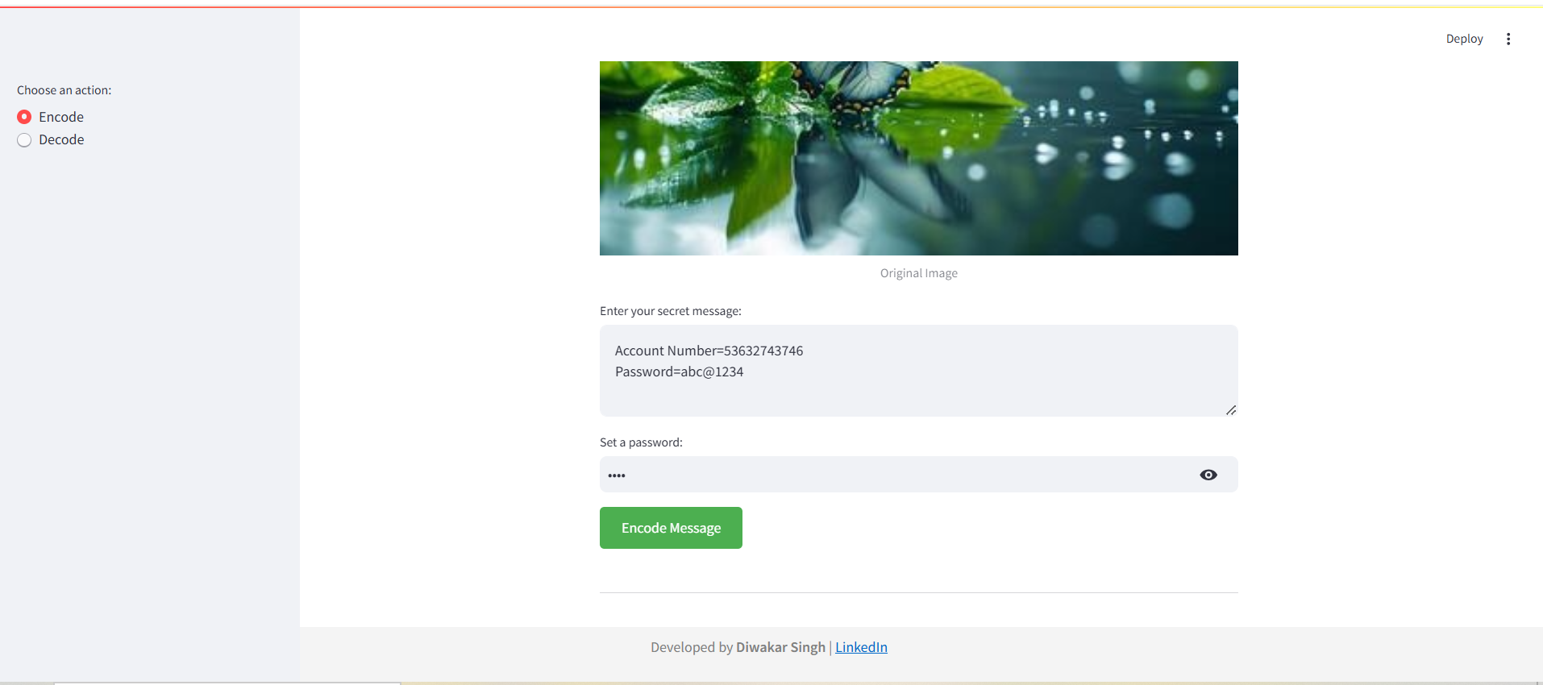
SET PASSWORD FOR THE MESSAGE

Slide 11
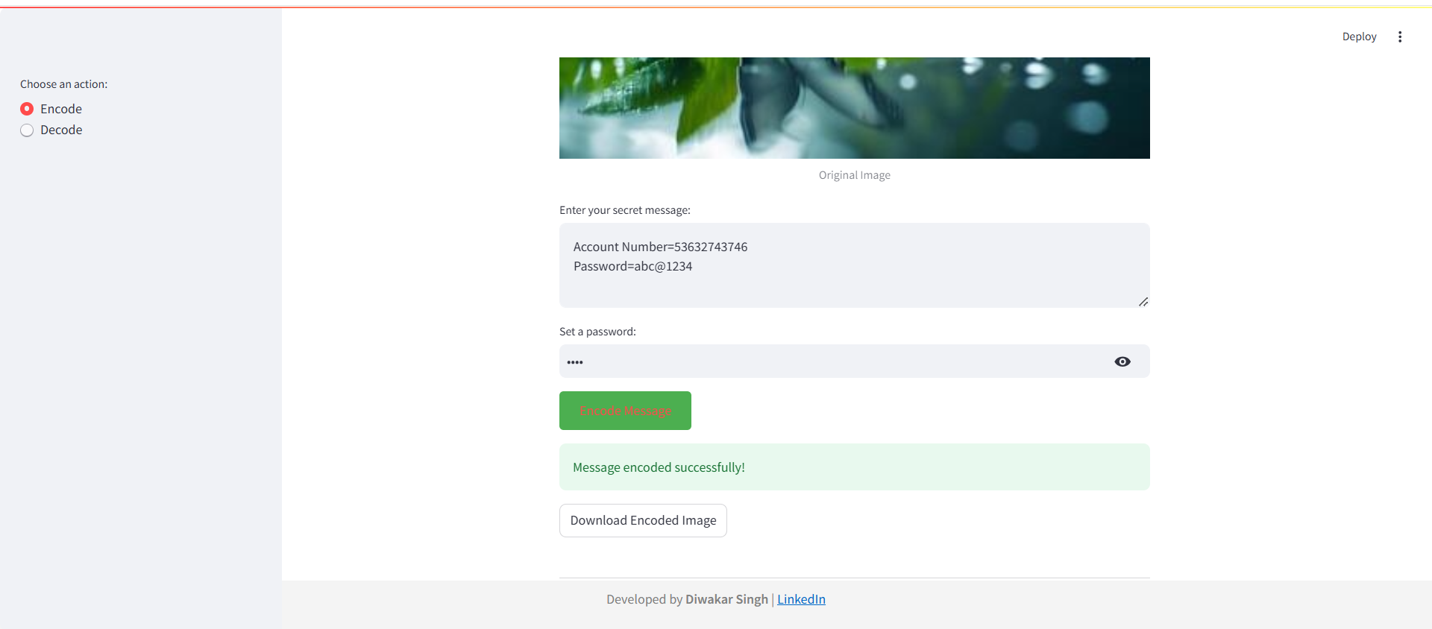
DOWNLOAD THE ENCRYPTED IMAGE

Slide 12
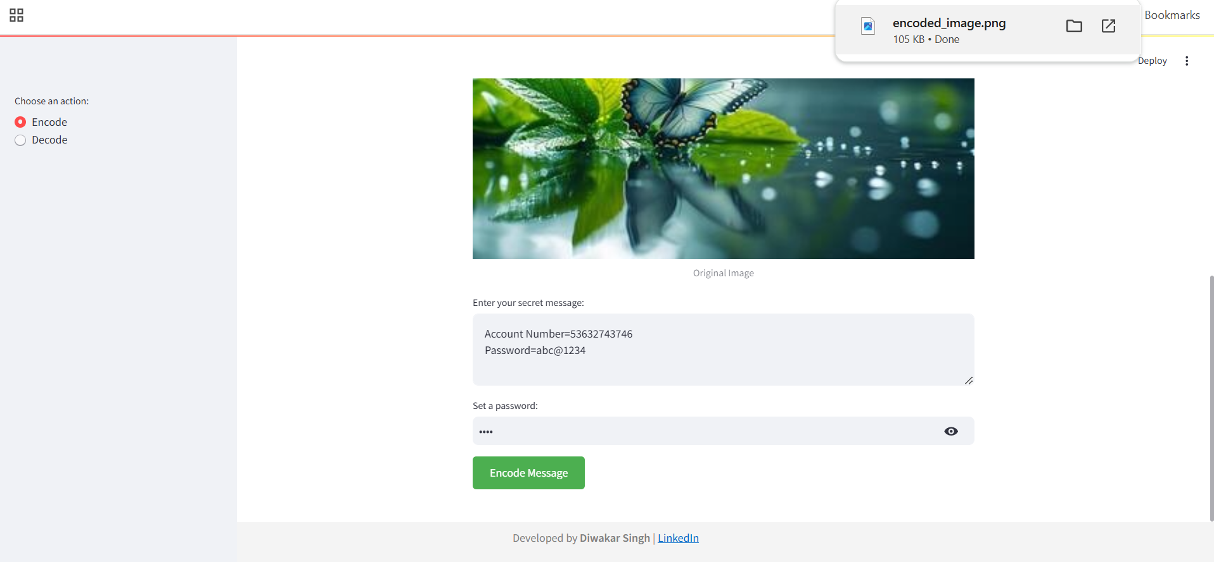
ENCRPTED IMAGE GETS DOWNLOADED

Slide 13
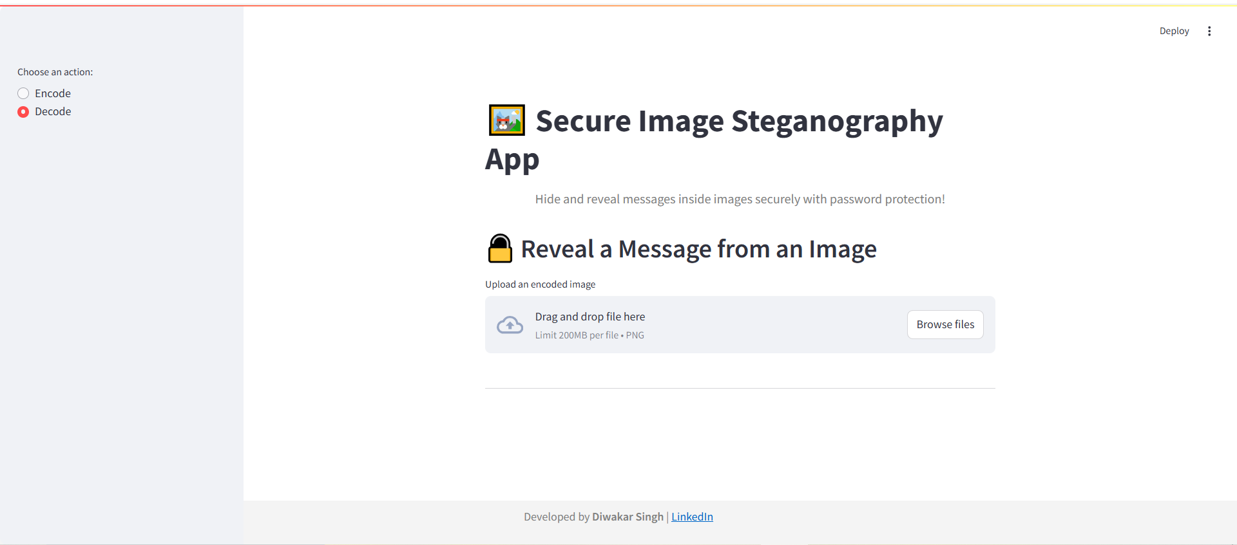
GUI FOR DECRPTION

Slide 14
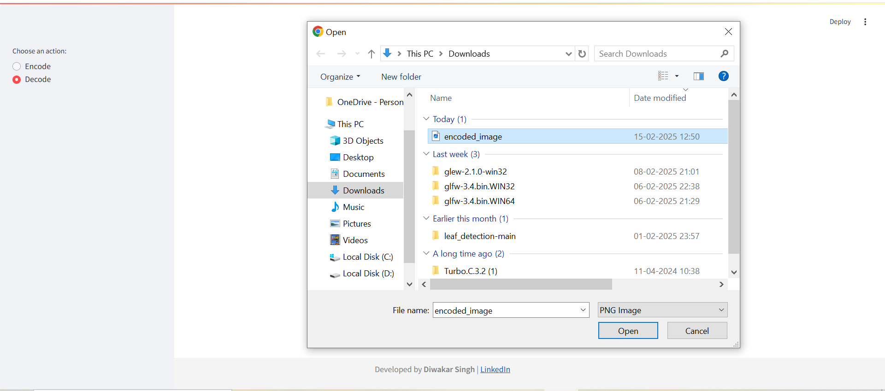
SELECT THE ENCRYPTED IMAGE

Slide 15
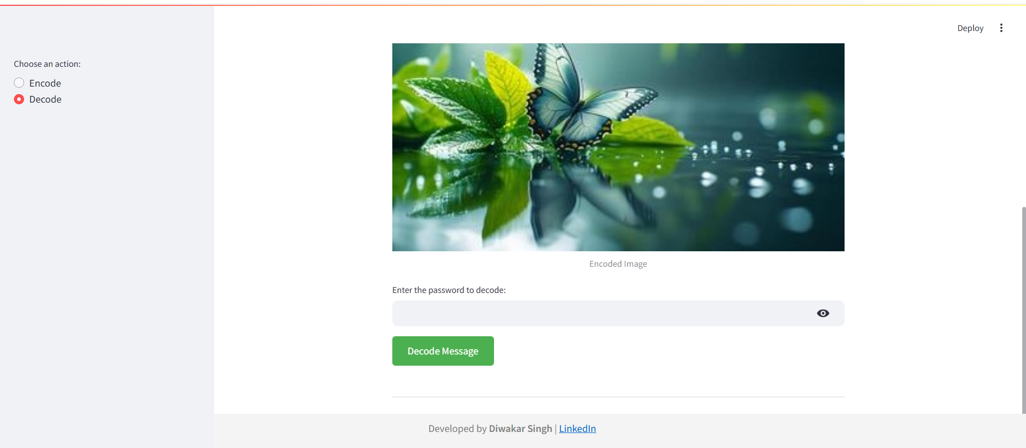
Enter the Correct password

Slide 16

MAKE SURE OF THE CREDENTIALS

Slide 17
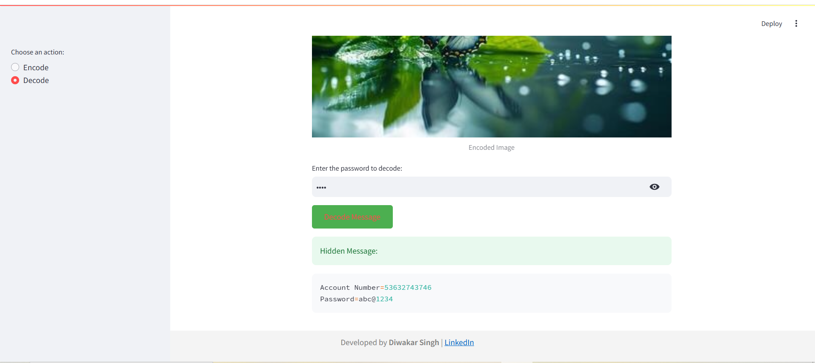
YOU CAN SEE THE DECRYPTED MESSAGE

Slide 18
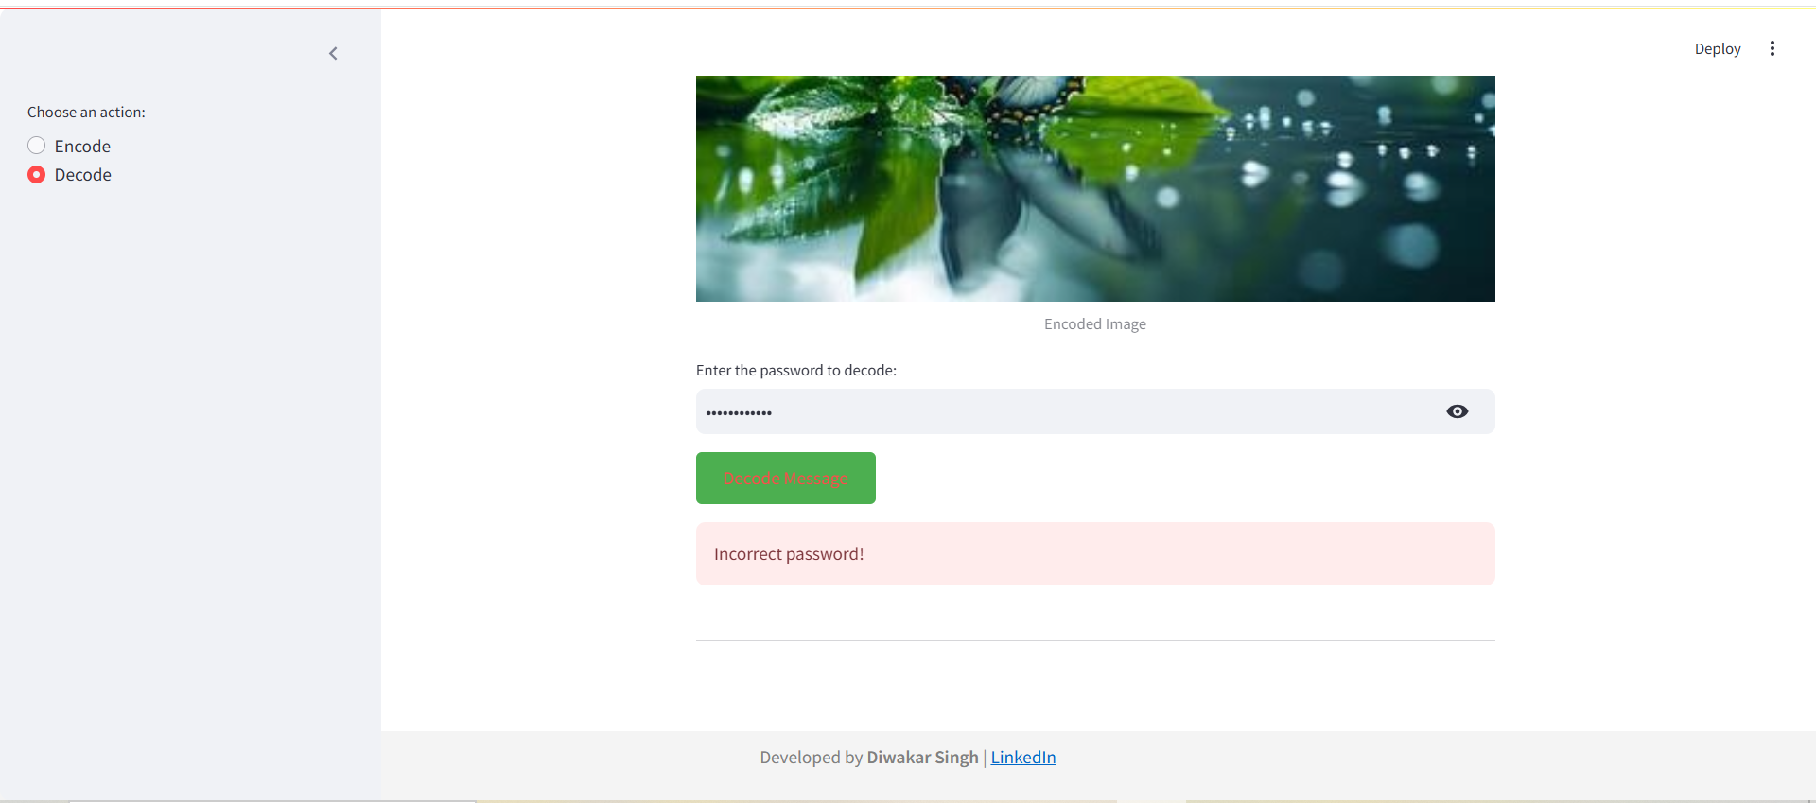
WITH WRONG CREDENTIALS , ENCRYPTED MESSAGE CANNOT BE ACCESSED

Slide 19
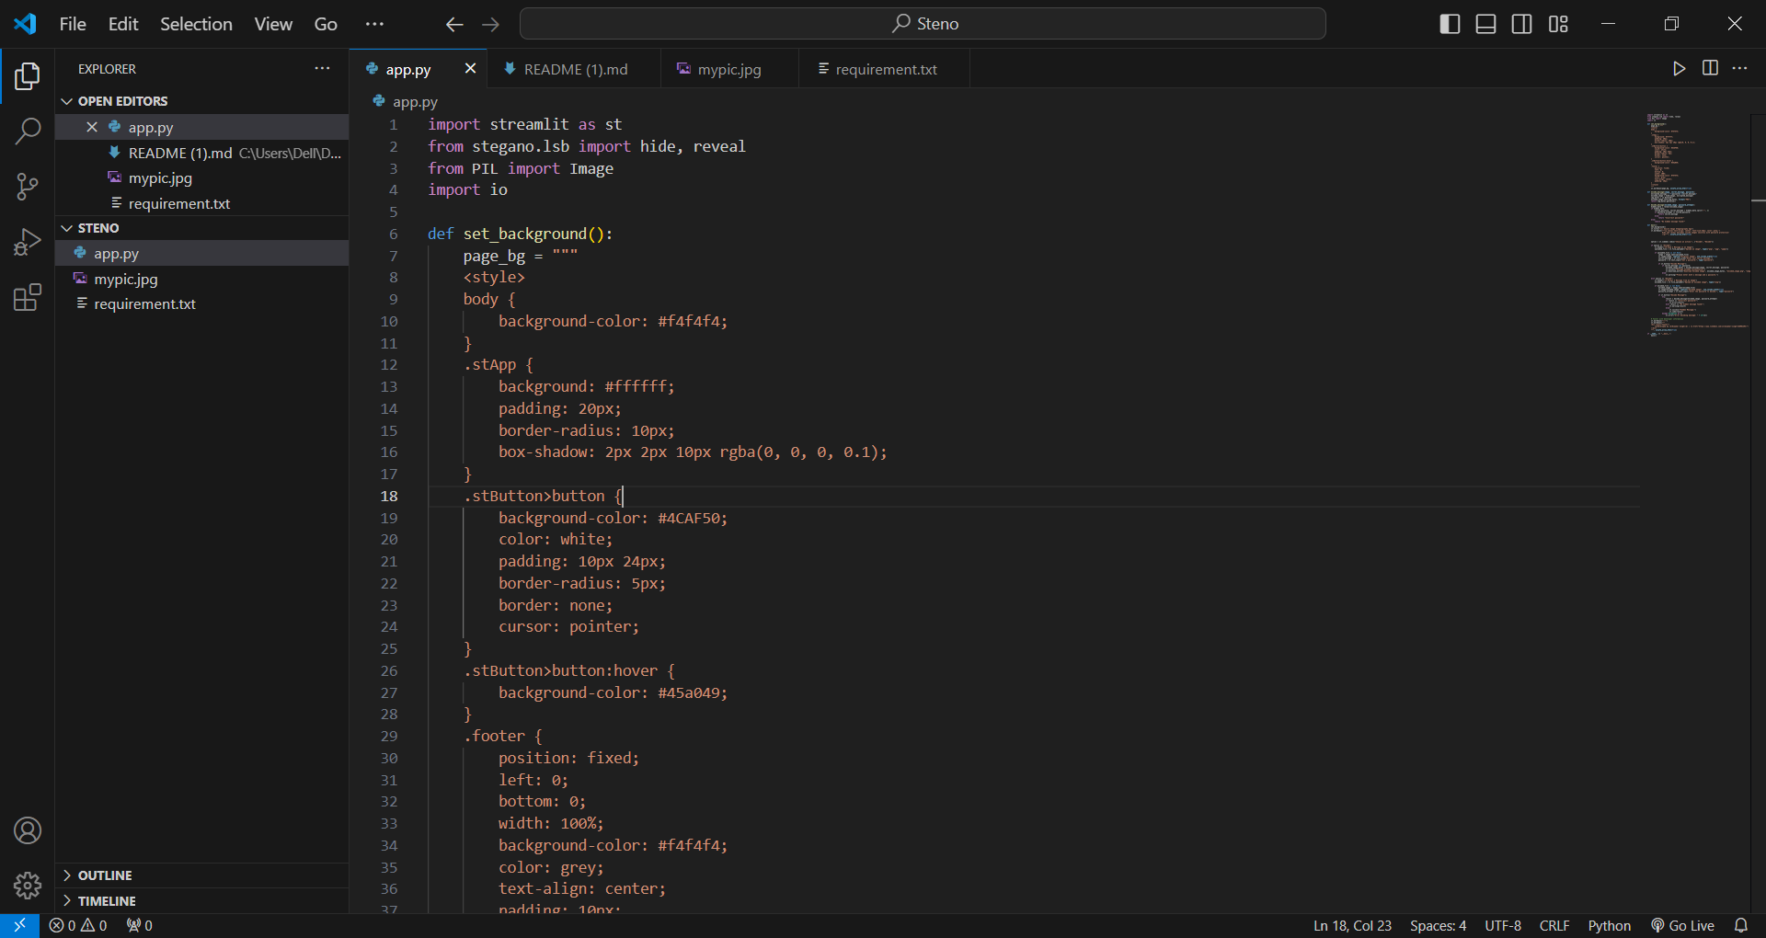
Code Snip-1

Slide 20
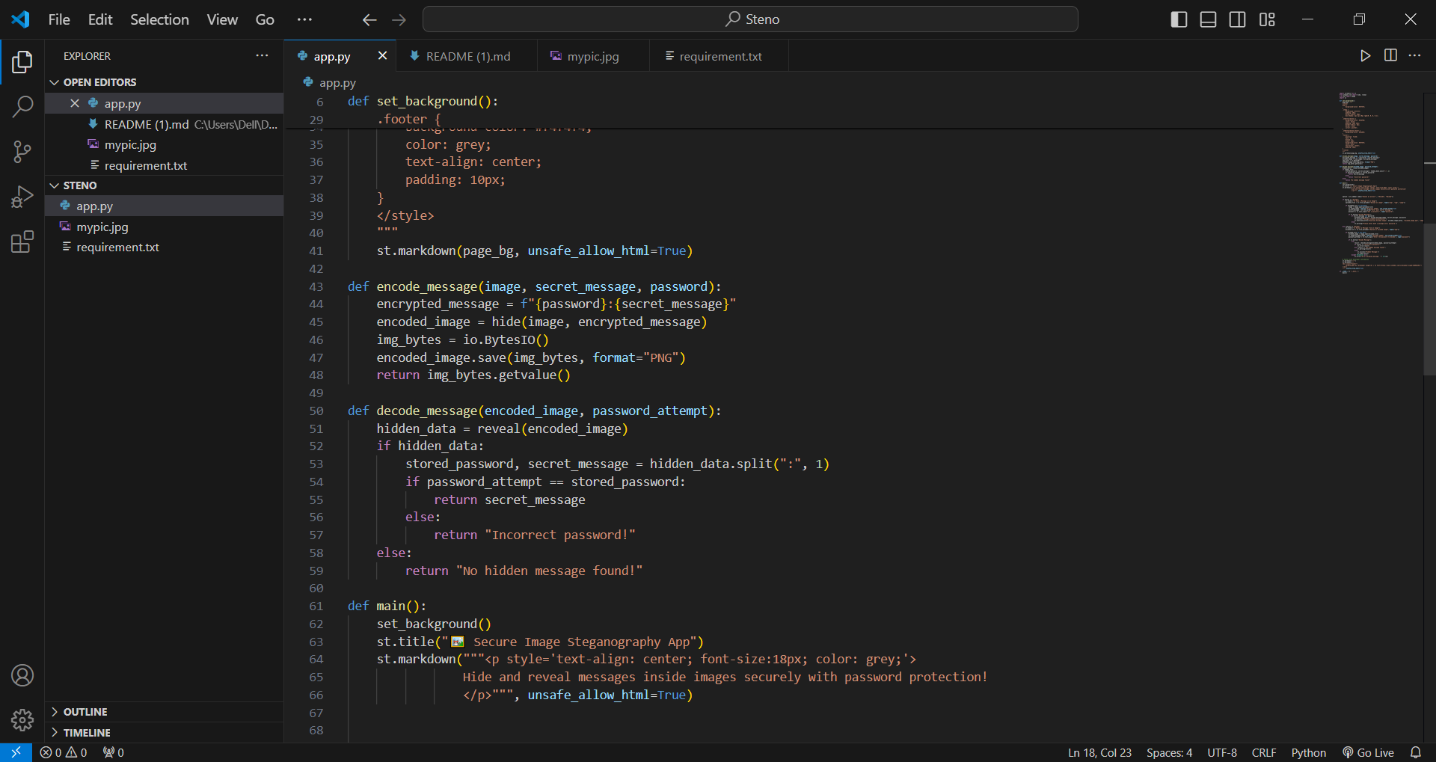
Code Snip-2

Slide 21
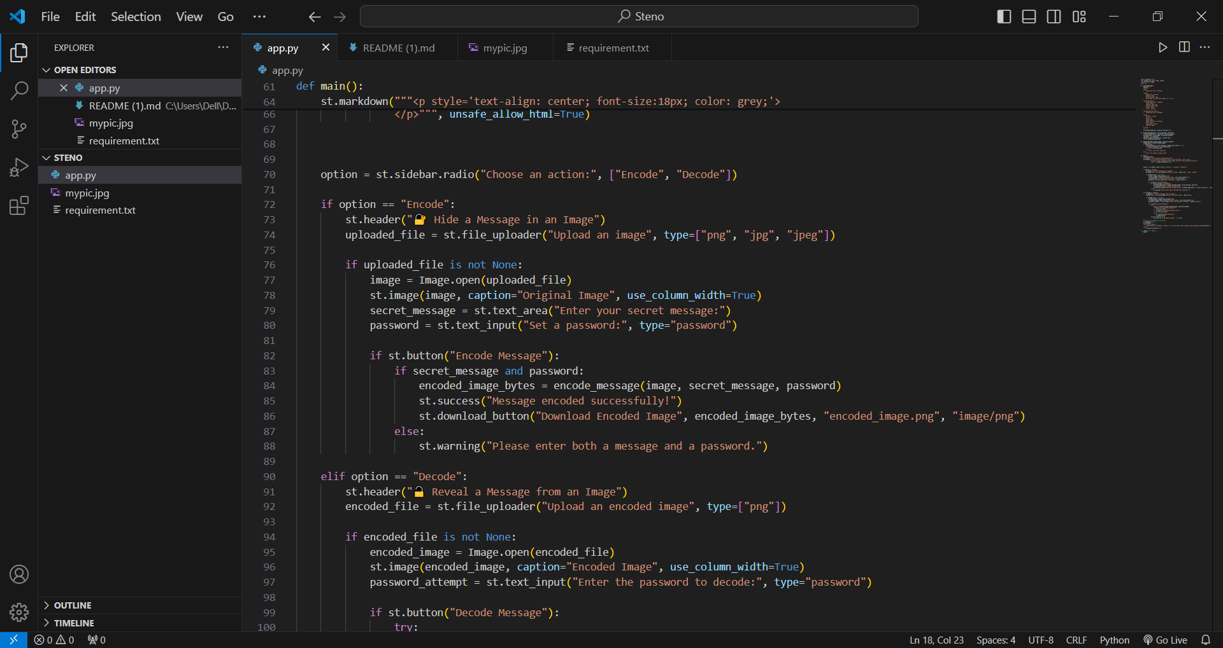
Code Snip-3

Slide 22
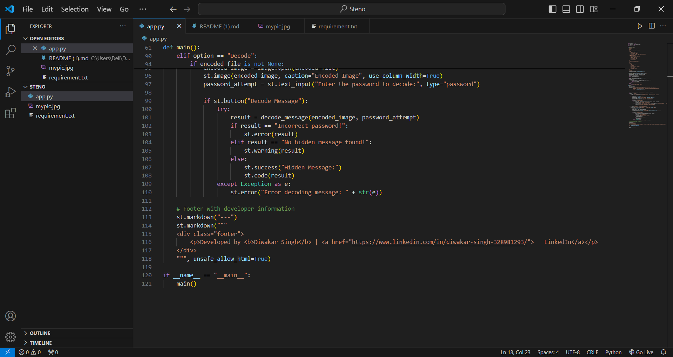
Code Snip-4

Slide 23
Conclusion
The Secure Data Hiding in Images Using Steganography project effectively addresses the problem of securely transmitting sensitive information while maintaining confidentiality and integrity. By leveraging steganography techniques, the project allows users to hide messages within images, ensuring that the data remains undetectable to unauthorized parties. The addition of password protection further enhances security, ensuring that only intended recipients with the correct password can decode and access the hidden information.
The project stands out due to its user-friendly interface, real-time encoding and decoding capabilities, and support for multiple image formats. It caters to a wide range of end users, including individuals, professionals, journalists, educators, and cybersecurity enthusiasts, providing a versatile tool for secure communication and data protection.
In conclusion, this project successfully bridges the gap between accessibility and security, offering a practical solution for secure data transmission in an increasingly digital world. It not only solves the problem of secure communication but also serves as an educational tool for understanding steganography and its applications.

Slide 24
GitHub Link
https://github.com/DiwakarSingh16/AI-Powered-Heath-Assistant-.git

Slide 25
Future scope(optional)
Advanced Encryption Algorithms:
Integrate stronger encryption methods (e.g., AES, RSA) to further secure the hidden messages, making it even more difficult for unauthorized users to decode the data.
Support for Additional Media Types:
Extend the project to support other media formats, such as audio and video files, enabling users to hide data in a wider range of digital content.
Multi-Layer Steganography:
Implement multi-layer steganography, where multiple messages or layers of data can be hidden within a single image, increasing the capacity and complexity of hidden information.
Cloud Integration:
Enable users to upload and store encoded images directly on cloud platforms (e.g., Google Drive, Dropbox) for easier sharing and accessibility.
Machine Learning for Detection Prevention:
Use machine learning algorithms to make the steganography process more robust against detection by advanced steganalysis tools.
Cross-Platform Mobile App:
Develop a mobile application version of the tool for iOS and Android, allowing users to encode and decode messages on the go.
Steganalysis Feature:
Include a feature to detect if an image contains hidden data, making the tool useful for both hiding and analyzing steganography.
User Authentication and Logs:
Implement user authentication (e.g., login system) and activity logs to track usage and ensure accountability for sensitive operations.
Enhanced UI/UX:
Improve the user interface with more interactive elements, animations, and customization options to make the tool more engaging and user-friendly.
Open-Source Collaboration:
Open-source the project to encourage collaboration from developers worldwide, leading to faster innovation and feature additions.

Slide 26
THANK YOU

